Slide 1
THE RESEARCH AGENDA
FOR SUSTAINABLE DEVELOPMENT
JEFFREY D. SACHS
DIRECTOR OF THE EARTH INSTITUTE
Elliott School of International Affairs
George Washington University
December 2, 2012

Slide 2
SUSTAINABLE DEVELOPMENT MEANS . . .
FOUR DIMENSIONS OF A HEALTHY SOCIETY
ECONOMIC PROSPERITY
SOCIAL INCLUSION
ENVIRONMENTAL SUSTAINABILITY
GOOD GOVERNANCE FOR SUSTAINABLE
DEVELOPMENT

Slide 3
In general,
Prosperity is achieved through balanced investments in infrastructure, human capital, and business capital.
Social inclusion is achieved by human capital investments for all, and human rights for all
Environmental sustainability is achieved by internalizing externalities and promoting sustainable technologies

Slide 4
Good governance entails:
Setting goals and plans for sustainable
development
Corporate good governance: no lobbying
no campaign financing, full disclosure, internalizing
externalities, polluter pays
Public provision of quality health, education,
and infrastructure
Contributing to global problem solving

Slide 5
THE WORLD IS DANGEROUSLY OFF COURSE:
Extreme poverty afflicting more than 1 billion
High and rising inequality in most societies
Degradation of the environment in all parts
of the world

Slide 6
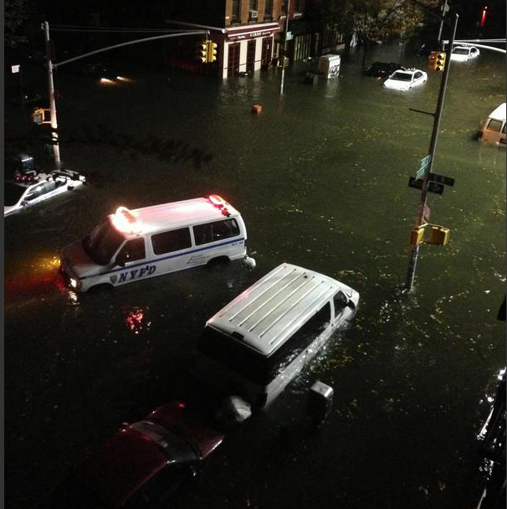
MANHATTAN, HURRICANE SANDY, OCTOBER 29, 2012

Slide 7
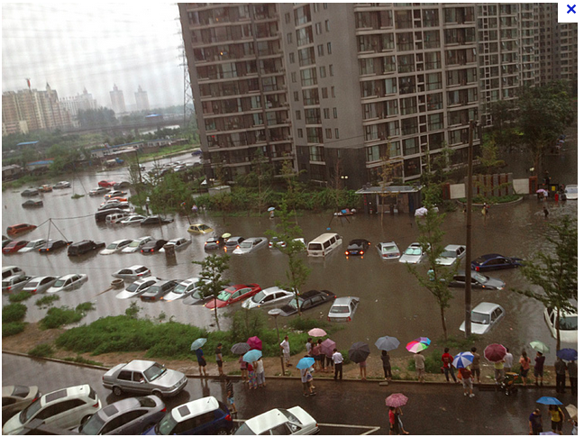
BEIJING, JULY 21, 2012

Slide 8
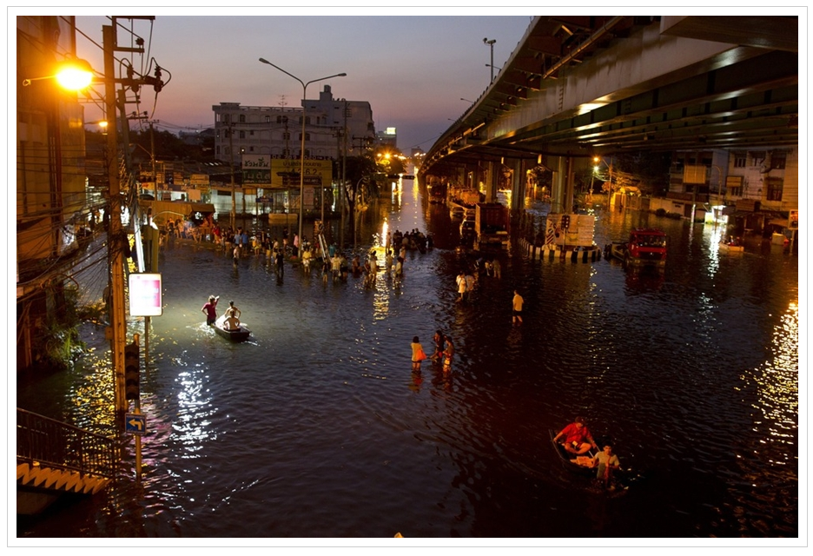
BANGKOK OCTOBER 2011

Slide 9
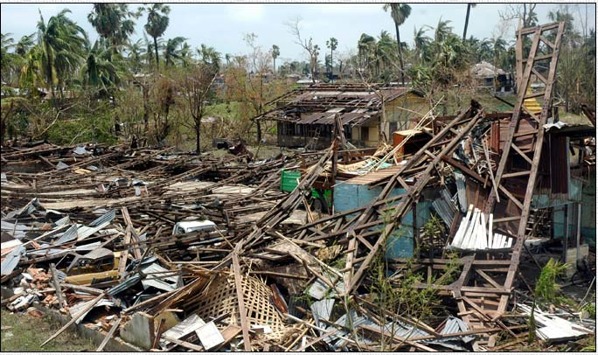
CYCLONE NARGIS, MYANMAR, 2008

Slide 10
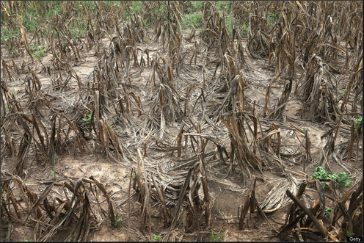
INDIANA MAIZE AUGUST 2012

Slide 11
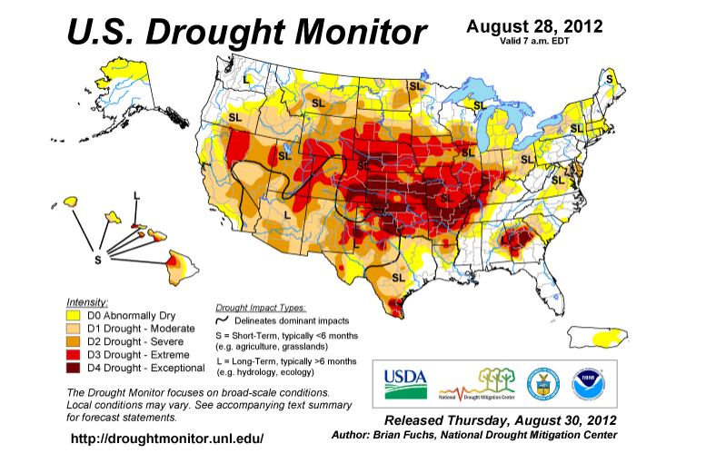

Slide 12
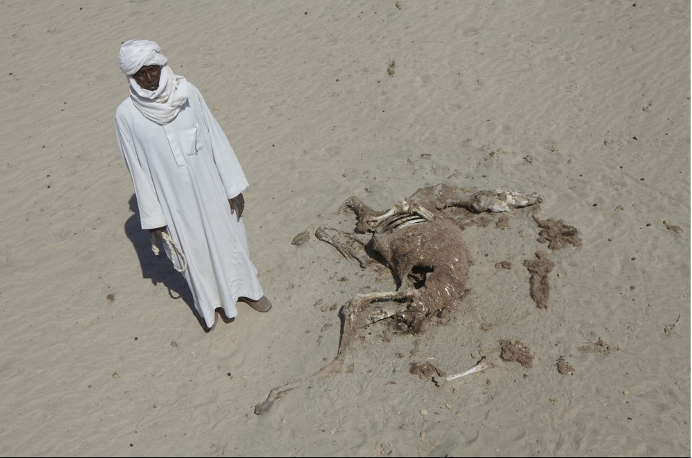
CHAD 2012

Slide 13
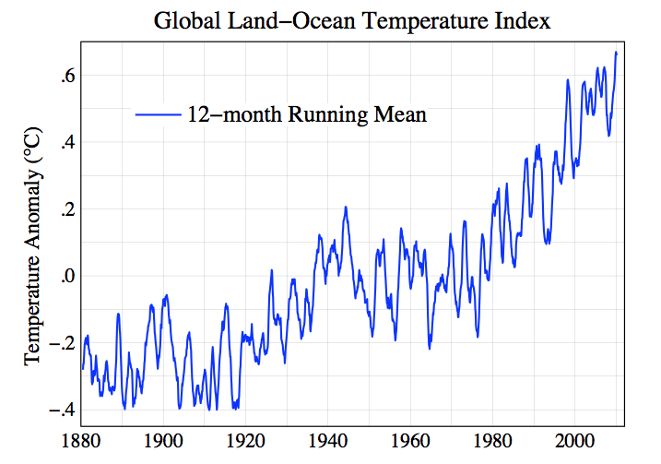
Source: Goddard Institute of Space Studies

Slide 14
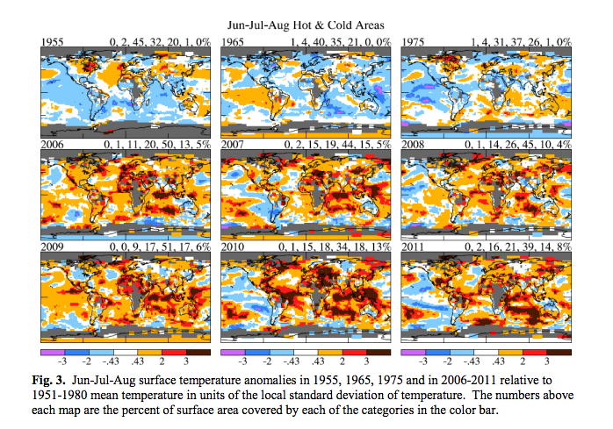

Slide 15
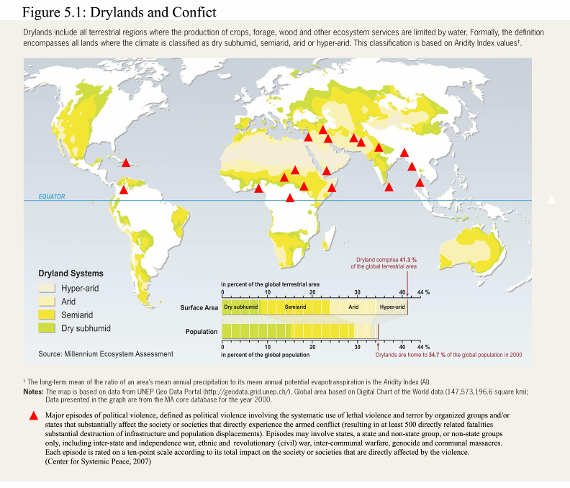

Slide 16
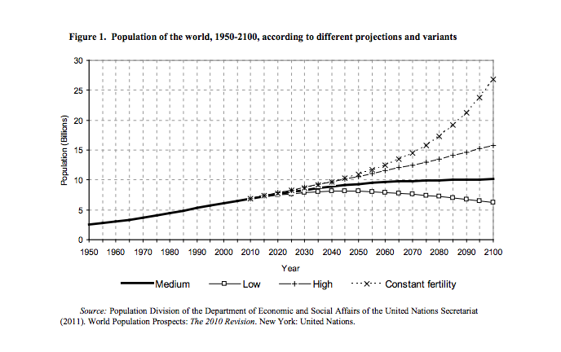

Slide 18
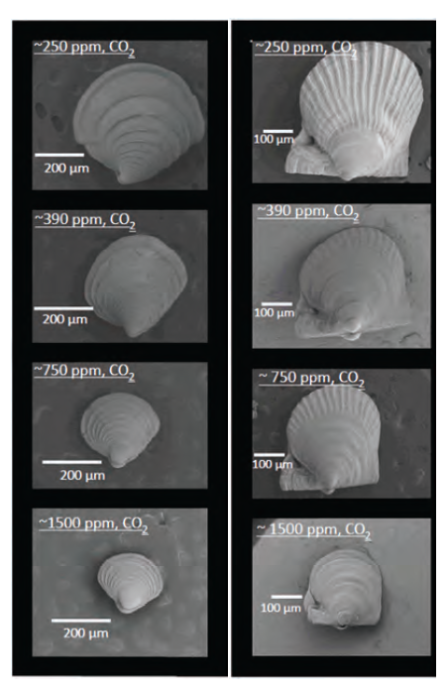
SHELLFISH GROWN
UNDER ALTERNATIVE CONCENTRATIONS OF CO2.
36-DAY OLD HARD CLAM
LARVAE ON LEFT,
52-DAY BAY SCALLOP LARVAE
ON RIGHT
SOURCE: WASHINGTON STATE BLUE RIBBON PANEL ON OCEAN ACIDIFICATION,
2012

Slide 19
GLOBAL RESPONSES TO THE CHALLENGES OF
SUSTAINABLE DEVELOPMENT
RIO EARTH SUMMIT (1992)
INTERNATIONAL LAW:
UNFCCC, CBD, UNCCD
RIO+20 (2012)
TECHNOLOGICAL BREAKTHROUGHS
GLOBAL CIVIL SOCIETY
SUSTAINABLE DEVELOPMENT GOALS

Slide 20
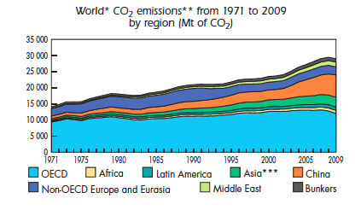
THE INDISPENSABLE ROLE OF ASIA

Slide 21
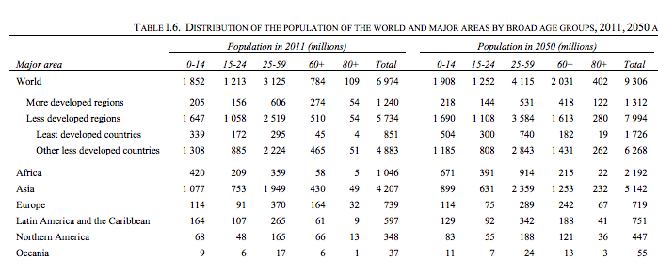
AS OF 2050, A REMARKABLE 80% OF WORKING AGE POPULATION, 25-59, WILL BE IN
ASIA AND AFRICA, UP FROM 74% TODAY.

Slide 22
FROM MDGS TO SDGS:
FOUR DIMENSIONS FOR SUSTAINABLE DEVELOPMENT GOALS:
END EXTREME POVERTY
SOCIALLY INCLUSIVE SOCIETIES
ENVIRONMENTAL SUSTAINABILITY
GOOD GOVERNANCE FOR SUSTAINABLE DEVELOPMENT

Slide 23
FOUR KEYS TO SUSTAINABLE DEVELOPMENT:
PROMOTION OF SUSTAINABLE TECHNOLOGIES
POLLUTER PAYS PRINCIPLE, INCLUDING CARBON TAXATION
PUBLIC INVESTMENT IN HEALTH, EDUCATION, NUTRITION, AND POVERTY REDUCTION
POLITICS FOR THE PEOPLE, NOT FOR THE VESTED INTERESTS

Slide 24
THE NEW GLOBAL PROBLEM SOLVING:
THE UN SUSTAINABLE DEVELOPMENT SOLUTIONS NETWORK (UN SDSN),
WITH THE SECRETARIAT AT THE EARTH
INSTITUTE

Slide 25
SOME KEY SUSTAINABLE DEVELOPMENT TECHNOLOGIES
LOW-CARBON ENERGY
RENEWABLE ENERGY
CARBON CAPTURE AND SEQUESTRATION
SMART VEHICLES, SMART CITIES, SMART BEHAVIOR
SUSTAINABLE AGRICULTURE
IMPROVED TRAITS (GMOs?), AGRO-ECOLOGY
SMART TILLAGE, MICRO-DOSING, DIETARY CHOICES,
OCEAN MANAGEMENT
SUSTAINABLE CITIES
POPULATION STABILIZATION
DIGITAL TECHNOLOGIES IN HEALTH, EDUCATION, MATERIALS
ALL HARNESS THE ONGOING INFORMATION REVOLUTION

Slide 26
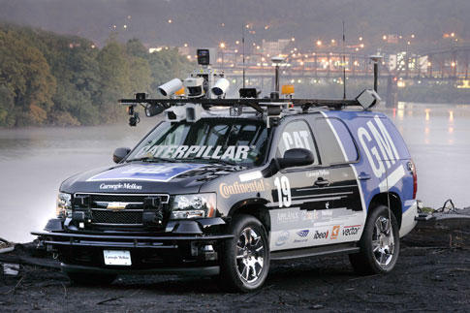
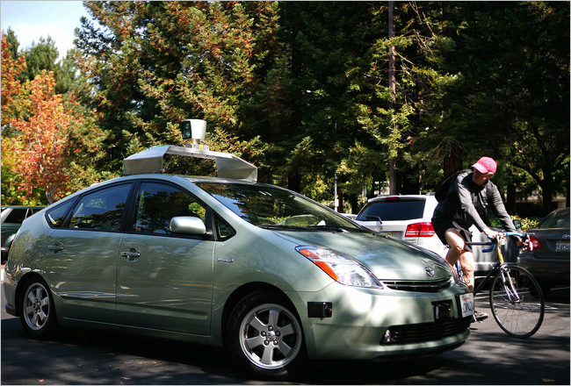
Self-Driving Cars
Google Self-Driving Car
DARPA Urban Challenge
Notes:
OnStar
DARPA
Google
Mobility Internet
Value Proposition

Slide 27
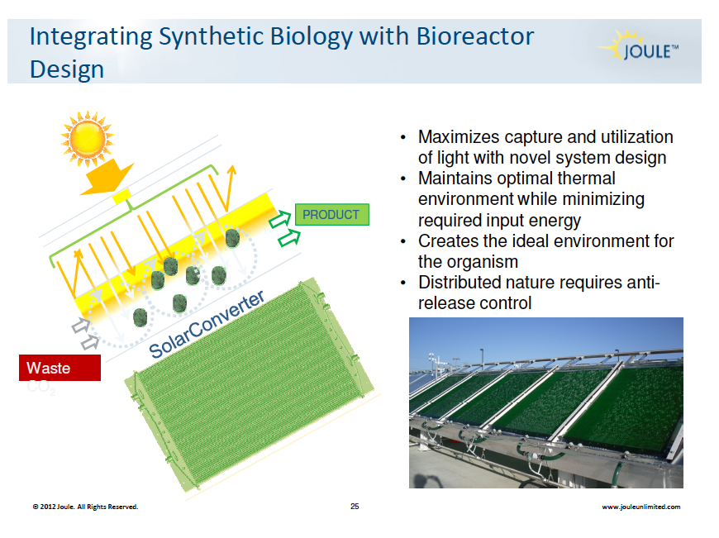

Slide 28
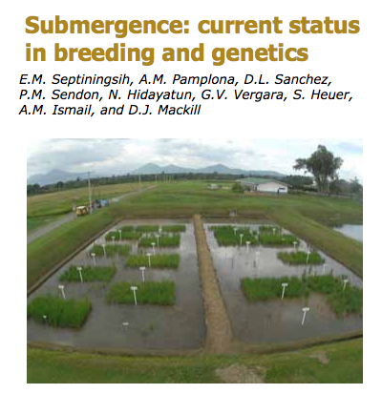

Slide 29
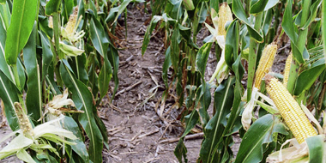
DROUGHT-RESISTANT VARITIES: CONVENTIONAL AND GMO
Drought-resistant variety (RHS) in field trials, 2007

Slide 30
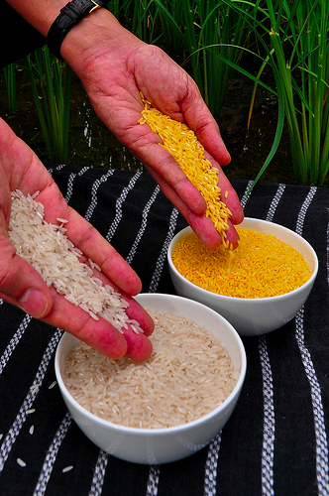
GOLDEN RICE,
FORTIFIED WITH
BETA-CAROTENE
SOURCE: IRRI

Slide 31
TWELVE SUSTAINABLE DEVELOPMENT
GRAND CHALLENGES
Macroeconomics, Population Dynamics, and Planetary Boundaries
Poverty Eradication and Peace-Building in Fragile Regions
Challenges of Social Inclusion: Gender, Inequalities, and Human Rights
Early childhood development, education, and transition to work
Health For All
Low-Carbon Energy and Sustainable Industry
Sustainable Agriculture
Forests, Oceans, Biodiversity and Ecosystem Services
Smart, Sustainable and Resilient Cities
Good Governance of Extractive and Land Resources
Global Rules and Mechanisms for Sustainable Development
Redefining the Role of Business for Sustainable Development

Slide 32
CHALLENGE NUMBER 1.
IDENTIFY THE GLOBAL AND REGIONAL RESOURCE
BOUNDARIES THAT MUST SET THE FRAMEWORK
FOR GLOBAL ECONOMIC GROWTH

Slide 33
CHALLENGE 2. IDENTIFY EFFICIENT AND
ROBUST PATHWAYS OF ECONOMIC
DEVELOPMENT FOR THE WORLD’S
IMPOVERISHED REGIONS:
HORN OF AFRICA
SAHEL
CONGO BASIN
CENTRAL ASIA
SOUTH ASIA
CENTRAL AMERICA AND HAITI
HIGH ANDES
*SMALL ISLAND STATES *LANDLOCKED STATES

Slide 34
CHALLENGE 3. SECURE GENDER AND
MINORITY RIGHTS
GENDER RIGHTS
RIGHTS OF INDIGENOUS COMMUNITIES
RIGHTS OF ETHNIC AND RELIGIOUS MINORITIES

Slide 35
CHALLENGE 4. FIND EFFICIENT INVESTMENTS
TO ENSURE COGNITIVE AND PHYSICAL
DEVELOPMENT OF ALL YOUNG CHILDREN.
STUNTING NUTRITION
INFECTION PRE-SCHOOL

Slide 36
CHALLENGE 5. DETERMINE EFFECTIVE
SYSTEMS FOR UNIVERSAL PRIMARY HEALTH
COVERGE FOR UNDER $100 PER PERSON
PER YEAR IN PUBLIC HEALTH OUTLAYS
(IN PART BY MOBILIZING NEW ICT TECHNOLOGIES)

Slide 37
CHALLENGE 6. ENSURE LOW-CARBON
ENERGY FOR ALL
RECOGNIZING THE RAPIDLY INCREASING
ENERGY NEEDS OF THE MAJOR EMERGING
ECONOMIES

Slide 38
CHALLENGE 7. ENSURE THAT EACH REGION
OF THE WORLD HAS FOOD SECURITY, PROMOTE
SMALLHOLDER FARMING, AND REDUCE THE
ECOLOGICAL IMPACTS OF FARMING:
NITROGEN CYCLE
WATER DEPLETION
GREENHOUSE GAS EMISSIONS
DEFORESTATION
INVASIVE SPECIES
HABITAT DESTRUCTION
LOSS OF GENETIC CROP DIVERSITY

Slide 39
CHALLENGE 8. PROTECT MAJOR ECOSYSTEMS
FROM CONTINUED ANTHROPOGENIC DAMAGE
OCEANS: OCEAN ACIDIFICATION AND OVERFISHING
MOUNTAINS: GLACIER RETREAT
WETLANDS: DRAINAGE
URBAN: POLLUTION
RAINFORESTS: DEFORESTATION
PASTURELANDS: OVERGRAZING
FARMLANDS: SOIL AND LAND EROSION ESTUARIES: EUTROPHICATION

Slide 40
CHALLENGE 9. CREATE A TOOLKIT FOR URBAN
SUSTAINBILITY
HAZARDS: STORMS, FLOODING, DROUGHTS, HEAT WAVES
GREEN AREAS
URBAN BIODIVERSITY ENERGY-EFFICIENT BUILDINGS REDUCED GHG EMISSIONS ENHANCED MOBILITY
PUBLIC HEALTH
CLEAN AIR, WATER, AND WASTE MANAGEMENT

Slide 41
CHALLENGE 10. PROMOTE SUSTAINABLE
RESOURCE PRACTICES IN COMMERCIAL
MINING AND AGRICULTURE
COMMUNITY LAND AND RESOURCE RIGHTS PROPER ROYALTY SYSTEMS
TRANSPARENCY OF PAYMENTS DUAL-USE INFRASTRUCTURE
CORPORATE ACCOUNTABILITY (E.G. NOMINEE BOARDS)

Slide 42
CHALLENGE 11. DESIGN EFFICIENT AND EQUITABLE
STANDARDS FOR THE GLOBAL COMMONS
RIGHT TO DEVELOP NORM OF CONVERGENCE POLLUTER PAYS
HISTORIC RESPONSIBILITY AID WITH GRADUATION
PREDICTABLE ASSESSMENTS FOR PUBLIC GOODS
TARGETS AND MILESTONES

Slide 43
CHALLENGE 12. REDESIGN CORPORATE
GOVERNANCE AND RESPONSIBILITY FOR
SUSTAINABLE DEVELOPMENT CLOSURE OF TAX HAVENS POLLUTER PAYS NO LOBBYING NO CAMPAIGN FINANCING PRICING OF ALL EXTERNALITIES

Slide 44

A Sustainable Planet?
The Pluses
Advanced Technologies
Information revolution
Corporate SD
Leadership
Sustainable Development
Goals
The Minuses
Population Pressures
Climate Change
Land Grabs
Lack of Planning
Global lawlessness

